Slide 1
Logic COMP2620/COMP6262/PHIL2080
Tutorial
Week8

Slide 2
Question 1:
Let's start with two semantic tableaux questions, which we should all be fine with by now.
Prove the following to be valid using semantic tableaux:
p → r, q → r ⊢ p ∨ q → r
True: p → r
True: q → r
False: p ∨ q → r
True: p ∨ q
False: r
q → r, p ⊢ r, p
r, q → r , p ⊢r
q → r, q ⊢ r, q
r, q → r , q ⊢r
→ ⊢
→ ⊢
p → r, q → r, p ⊢ r
p → r, q → r, q ⊢ r
∨ ⊢
True: p
True: q
p → r, q → r, (p ∨ q) ⊢ r
⊢ →
False: p
True: r
False: q
True: r
p → r, q → r ⊢ (p ∨ q) → r

Slide 3
Question 1:
Let's start with two semantic tableaux questions, which we should all be fine with by now.
Prove the following to be valid using semantic tableaux:
2. ∃x¬ Fx ∨ ∃x Gx ⊢ ∃x (Fx → Gx)
A✖️
Fa ⊢ Fa, Ga
True: ∃x¬ Fx ∨ ∃x Gx
False: ∃x (Fx → Gx)
A✖️
¬ Fa , Fa ⊢ Ga
Ga, Fa ⊢ Ga
⊢ →
⊢ →
¬ Fa ⊢ Fa → Ga
Ga ⊢ Fa → Ga
True: ∃x¬ Fx
True: Fa
False: Fa →Ga
True: Fa
False: Ga
False Fa
True: ∃x Gx
True: Ga
False: Fa →Ga
True: Fa
False: Ga
∃ ⊢
∃ ⊢
¬ Fa ⊢ ∃x (Fx → Gx)
Ga⊢ ∃x (Fx → Gx)
⊢ ∃
⊢ ∃
∃x¬ Fx ⊢ ∃x (Fx → Gx)
∃x Gx ⊢ ∃x (Fx → Gx)
∨ ⊢
✖️
∃x¬ Fx ∨ ∃x Gx ⊢ ∃x (Fx → Gx)

Slide 4
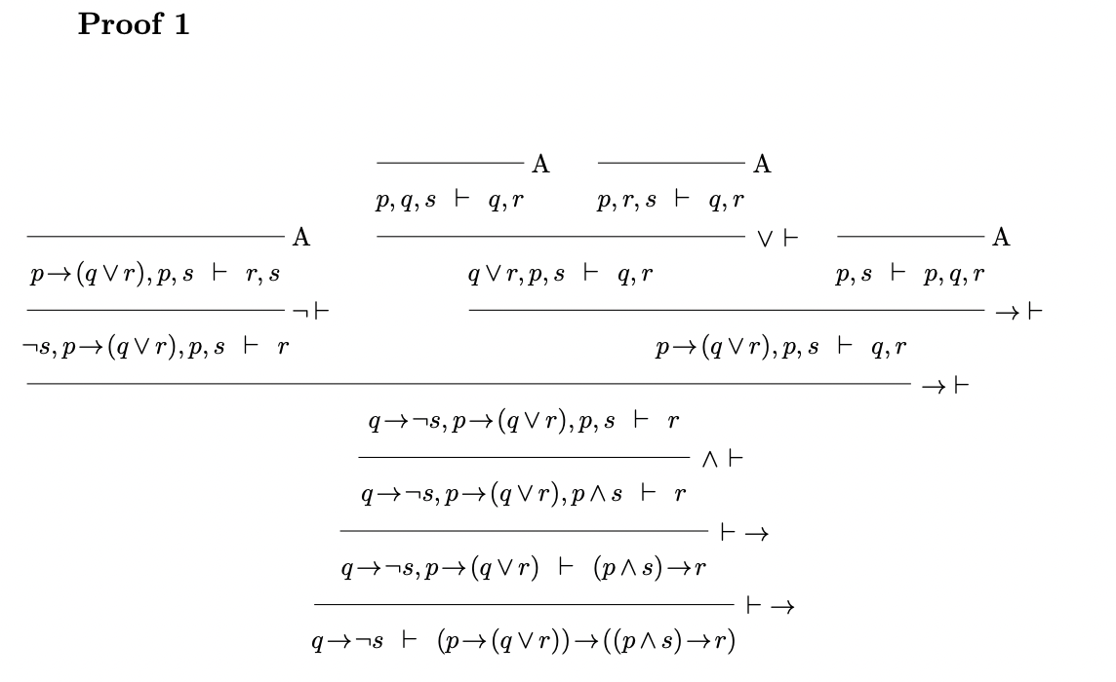
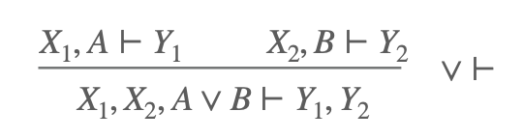
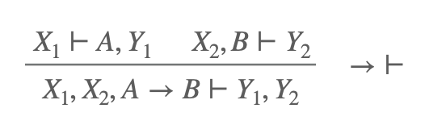
All branches close, and the sequent is valid

Slide 5
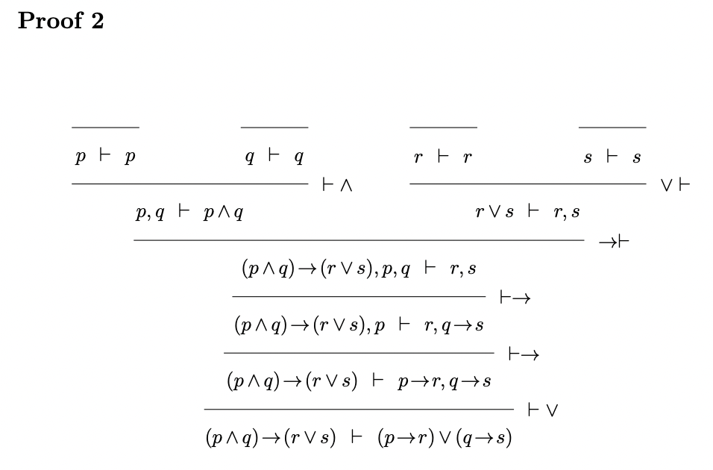
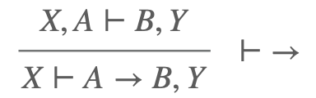
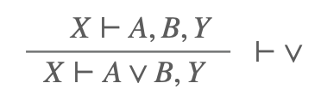
Notice how smooth and easy this proof is, in comparison with the monster of a natural deduction proof, given as the last propositional logic exercise in the Course Notes.

Slide 6
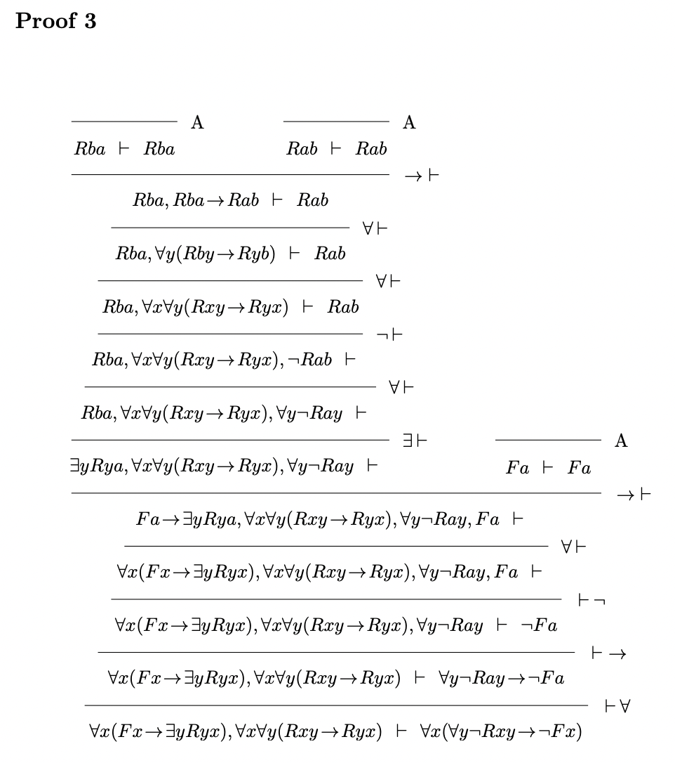

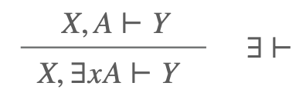
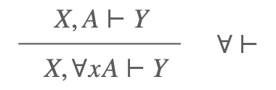
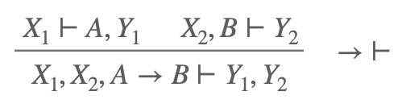
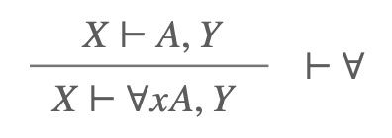
p → r, q → r ⊢ p ∨ q → r
∃x¬ Fx ∨ ∃x Gx ⊢ ∃x (Fx → Gx)
Note that the rule for → on the left has been amended slightly to allow the left and right sequents above the line to share the side formulae rather than both having all of them. This makes no essential difference, but reduces the amount of clutter when the proof is written out.

Slide 7
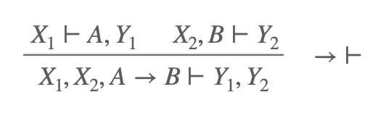
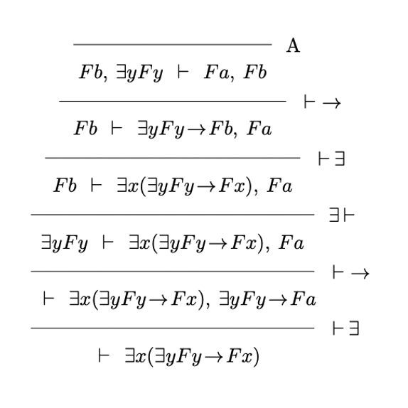
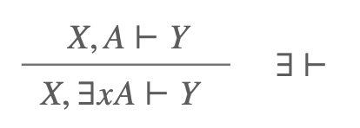
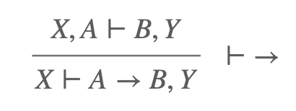
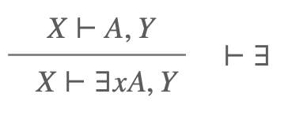
The proof essentially involves contraction (at the last step) and also requires the sequents to be multiple on the right.
The contraction move is tricky in the sequent calculus notation, though somehow in the corresponding tableau it happens easily.

